Slide 2
OpenStack
The platform ecosystem for the cloud
Jonathan Bryce
Executive Director, OpenStack Foundation
@jbryce

Slide 3
What is
OpenStack?

Slide 4
More than…
…cloud infrastructure software
…a global open source community
…a collaboration among technology vendors
Notes:
‣

Slide 5
The platform ecosystem for the cloud
    Different than other cloud software or services
    Creates the most value for users
Notes:
‣

Slide 6
Platform Ecosystems:
How do they work?

Slide 7

Platform Ecosystems – Three Forces
TECHNOLOGY
PLATFORM
INNOVATIVE
ECOSYSTEM
GLOBAL USER
FOOTPRINT

Slide 8
Apple
iOS
800,000+ apps
106 carriers
500,000,000+ devices
113 countries

Slide 9
Android
Android
800,000+ apps
95 carriers
44 device makers
750,000,000 devices
104 countries

Slide 10
Facebook
Facebook
Developer Platform
9,000,000 apps
1,000,000,000+ users
82% non-US & Canada

Slide 11
OpenStack
OpenStack
Software
Tools
Services
Software
Private clouds
Public clouds

Slide 12

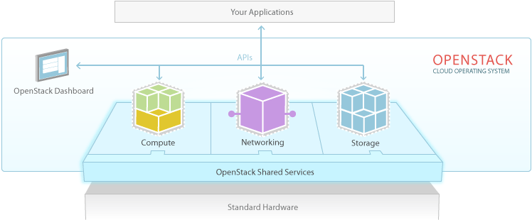
OpenStack Cloud Platform
Technology Platform
  Code available under Apache 2.0 license. Design tenets – scale & elasticity, share nothing & distribute everything

Slide 13
OpenStack Capabilities
Technology Platform
Compute | Provision and manage large pools of on-demand computing resources
Object Storage | Petabytes of reliable storage on standard gear
Block Storage | Volumes on commodity storage gear, and drivers for more advanced systems like IBM, EMC, HP, Red Hat/Gluster, Ceph/RBD, NetApp, SolidFire, and Nexenta
Networking | Software defined networking automation with pluggable backends
Dashboard | Self-service, role-based web interface for users and administrators
Shared Services | Multi-tenant authentication system that ties to existing stores (e.g. LDAP), Image Service

Slide 14
Open Development Process
Technology Platform
Time-Based Release Cycle
New software release every six months, with interim milestones
Twice Yearly Design Summits
Immediately following software release to plan next version Sessions led by developers and Project Technical Leads
Broad Contributions
1000 developers, from over 50 companies worldwide
Elected Leadership
Developers elect their own Project Technical Leaders

Slide 15

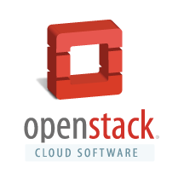
Broad Support and Contribution
Innovative Ecosystem
209
Companies
9,511
ECOSYSTEM SIZE
(Members + Sponsors + Supporters)
INDIVIDUAL MEMBERS
TOP 10 Countries
1) United States
2) China
3) India
4) Great Britain
5) Australia
6) France
7) Russia
8) Canada
9) Ireland
10) Germany
Members: 24 Total
Sponsors: 35 Total
Supporters: 150 Total
CUMULATIVE
CONTRIBUTORS
AVERAGE MONTHLY
CONTRIBUTORS
PATCHES
MERGED
998
230
7,260
(Grizzly Release Cycle – Six Months)
15

Slide 16

















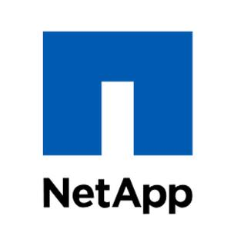


Platinum & Gold Members
Innovative Ecosystem
8

Slide 17

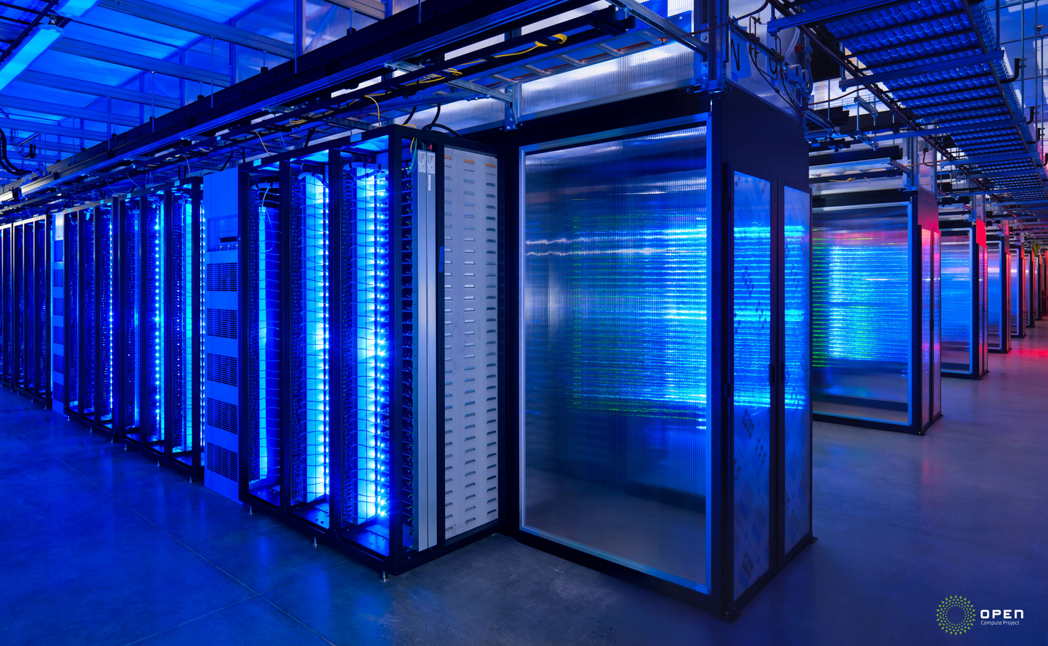
OpenStack Use Cases: IT Transformation
User Footprint
Every datacenter
Every server
Every network device
Every storage system

Slide 18
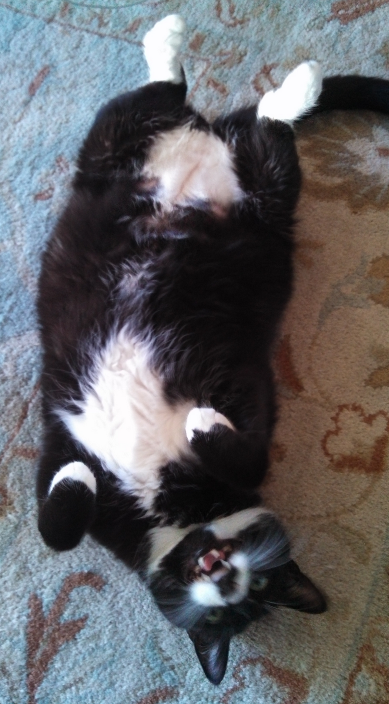
OpenStack’s Goal: Change IT
User Footprint
Every datacenter
Every server
Every network device
Every storage system
Every silly cat photo

Slide 19


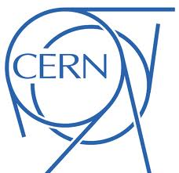
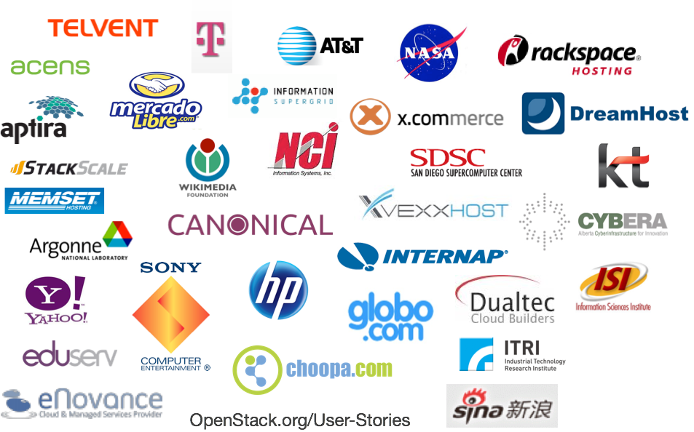

Diverse Use Cases
User Footprint

Slide 20
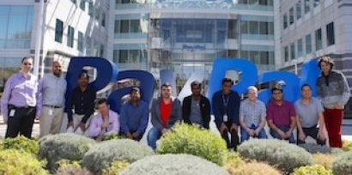
PayPal Uses OpenStack
User Footprint
“We needed agility without sacrificing availability. By leveraging the collective innovation of the OpenStack community, we can develop and grow our private cloud much quicker without having to reinvent anything.”
Processed more than $26,000 in mobile payments every minute in 2012
OpenStack runs thousands of VMs to support their self-service developer model
Internal team manages deployment and operations, using OpenStack Compute, Storage & Shared Services
Saran Mandair, senior director of infrastructure engineering, PayPal
Notes:
20

Slide 21
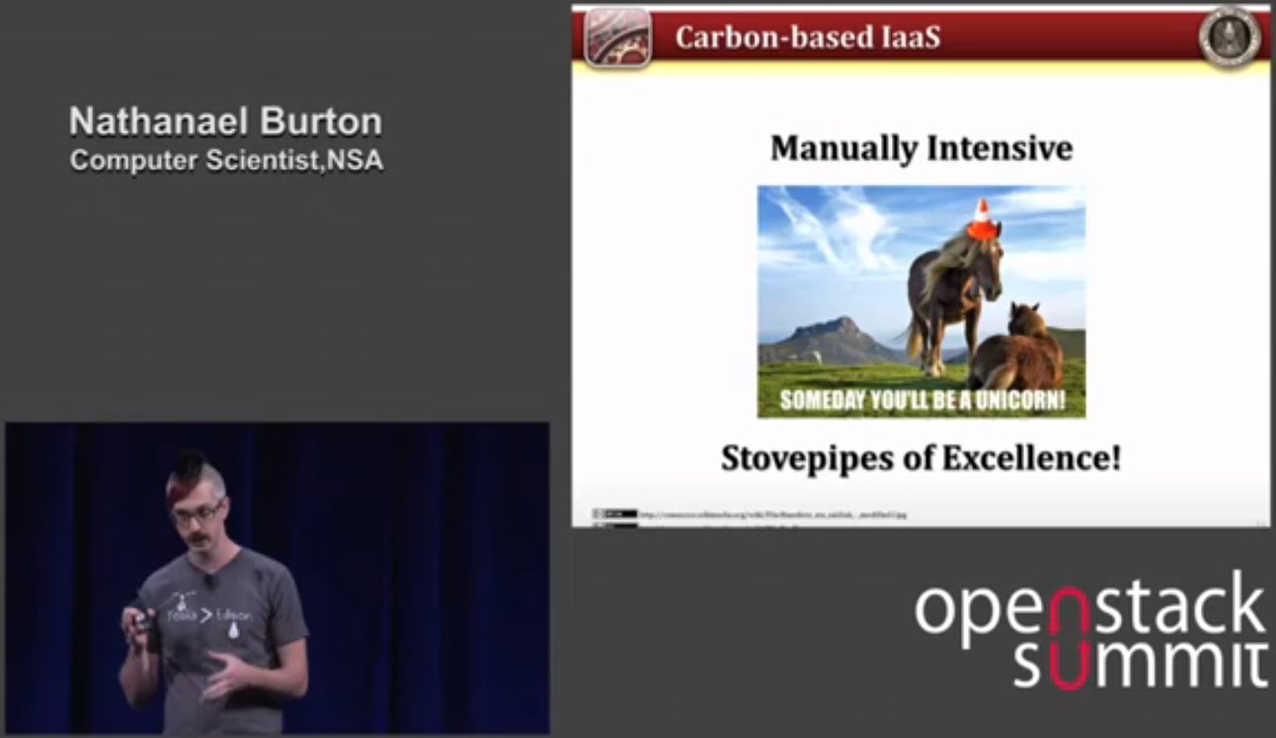

NSA Uses OpenStack
User Footprint
Cloud at NSA is all about big data,
Wanted to drastically reduce barriers and time to go from idea to capability
Generally available, tied into standard auth systems, running production work loads on mission data
Nathanael Burton, computer scientist, NSA
Notes:
21

Slide 22

IBS DataFort Uses OpenStack
User Footprint
“We want our customers to have freedom of choice. We do believe that OpenStack is bringing that dimension. Russia has a long, long history of being dominated by one party – freedom of choice is important from a historical perspective, similar trend that you observe everywhere.”
8,000 Employees, provide IT support for over 120 Russian and overseas companies.
Operate 3 datacenters with 5000+ Servers
Working with CloudScaling to deploy private and public OpenStack Clouds this year
Michal Cupa, president, IBS DataFort
Notes:
22

Slide 23
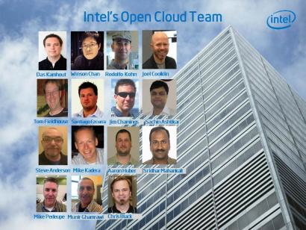
Intel Uses OpenStack
User Footprint
“OpenStack has dramatically reduced the amount of time it takes to provision services and automatically resolve resource issues. We can now deploy a VM in just five to 10 minutes, provide faster self services to our customers, and offer a more reliable infrastructure with rolling updates that will keep our infrastructure current without burdening our staff.”
Intel IT supports more than 75,000 servers in 69 data centers
And more than 91,000 employees who connect to Intel resources through more than 138,000 mobile devices.
Das Kamhout, principal engineer and cloud lead, Intel
Notes:
23

Slide 24
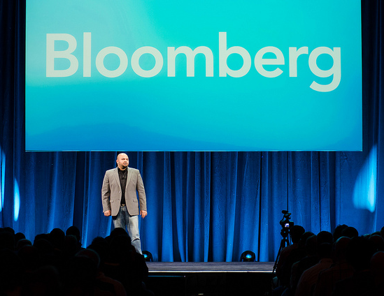
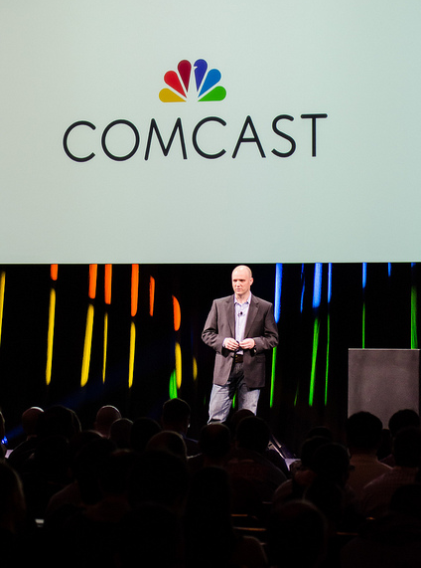
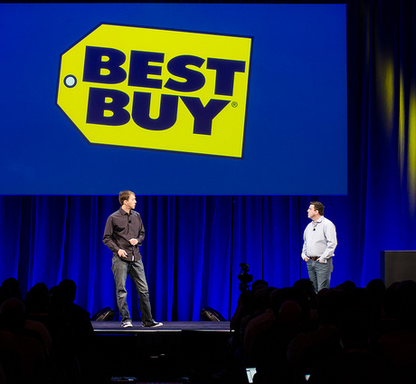
Bloomberg, Comcast, Best Buy
User Footprint
http://www.openstack.org/summit/portland-2013/session-videos/
Notes:
24

Slide 25
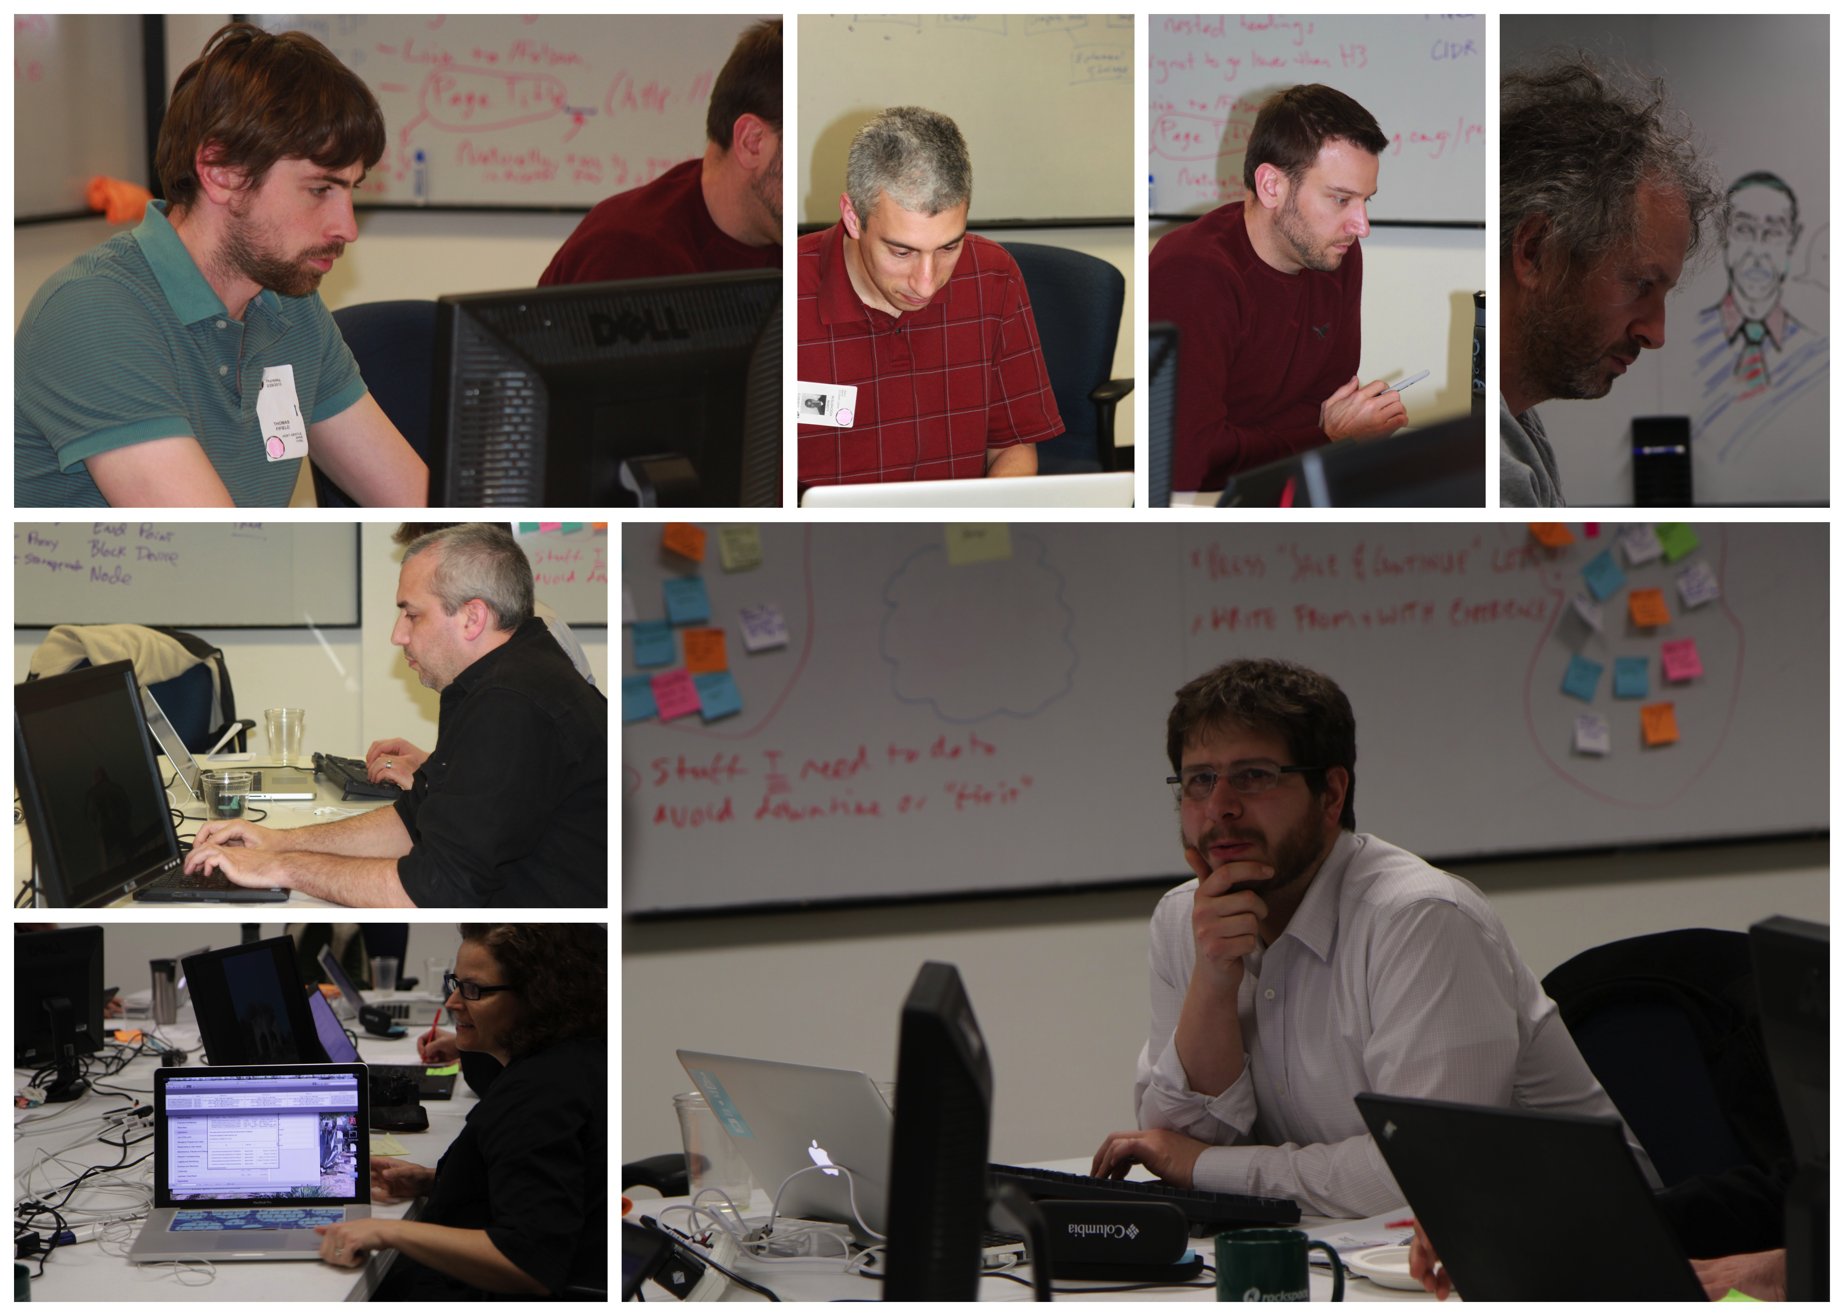
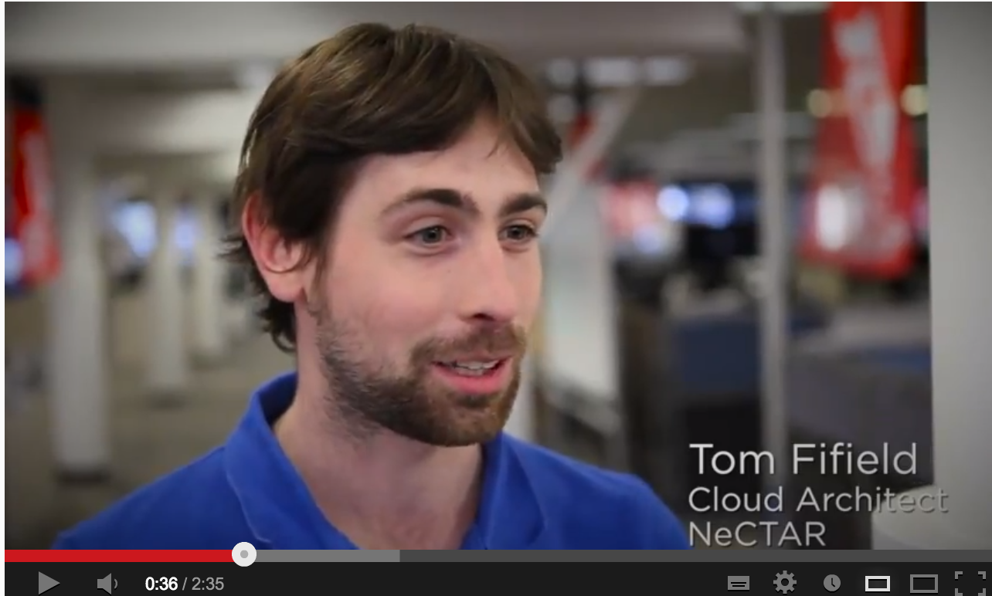
Empowered Users Make OpenStack Better
User Footprint
http://bit.ly/guidevideo
Authors with experience operating OpenStack came from all over the world to Austin, Texas to write a book in just 5 days!

Slide 26
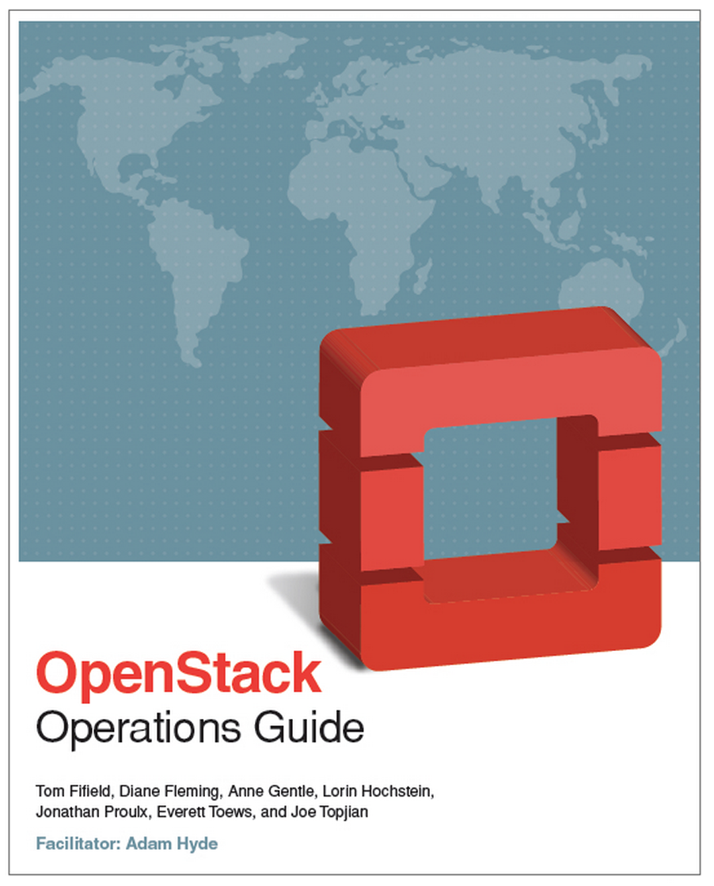
OpenStack Operations Guide: In 5 Days!
User Footprint
230+ Pages in 5 days.
Written by experienced OpenStack operators.
In less than a week of publication, the book was downloaded over 2,000 times… now over 5,000 downloads!

Slide 27
Who is behind
OpenStack?

Slide 28
The OpenStack Foundation
Protecting, Empowering, and Promoting OpenStack software and the community around it, including users, developers and the entire ecosystem.
Over 9,500 Individual Members, up from 5,600 at launch
The leading Global IT companies as Gold & Platinum Members
Board of Directors that sets strategic direction
Project Technical Leads and a Technical Committee that are elected from among the contributors
User Committee to ensure the users voices are heard

Slide 29
Foundation Approach
Provide a permanent legal home for OpenStack, with broad industry support and the resources to support OpenStack’s success
While preserving what’s working – a.k.a. the “OpenStack Way”
Technical people making technical decisions based on merit
Dedicated resources building the community and ecosystem
A strong ecosystem of companies making money
Encouraging and rewarding contribution in all forms

Slide 30
OpenStack Summit Attendee Growth
Expecting 4000+ in Hong Kong: November 5-8, 2013
Notes:
Growth in Summit attendees - 75 to more than 1300
Planning for 1800 in April 2013

Slide 31
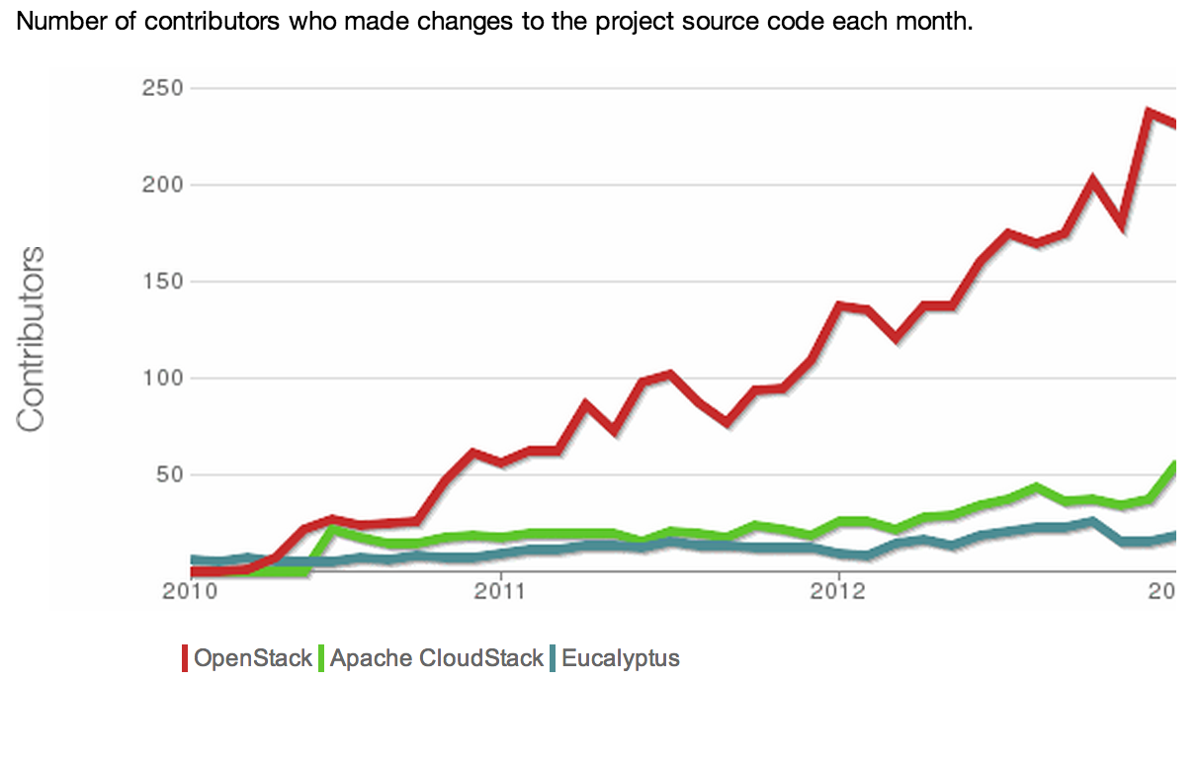
Developer Interest & Commitment to Platform
Average of 230+ unique contributors per month
Contributors
http://www.ohloh.net/p/compare?project_0=OpenStack&project_1=Apache+CloudStack&project_2=Eucalyptus

Slide 32
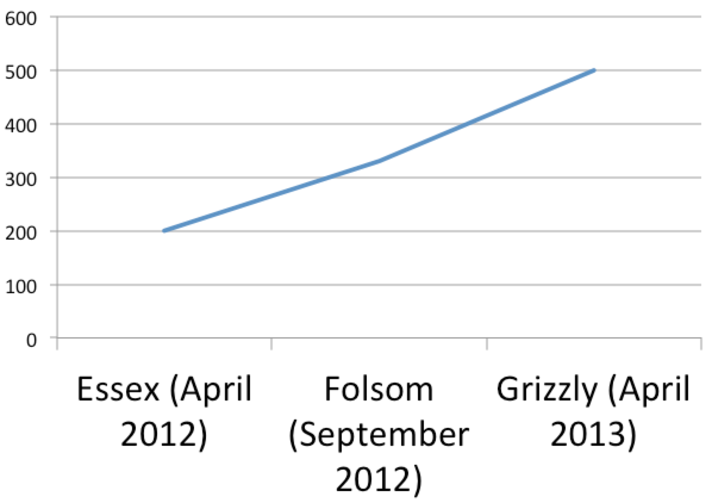
Developer Interest & Commitment to Platform
More than doubled number of contributors from Essex to Grizzly
http://www.ohloh.net/p/compare?project_0=CloudStack&project_1=OpenStack&project_2=Apache+CloudStack

Slide 33
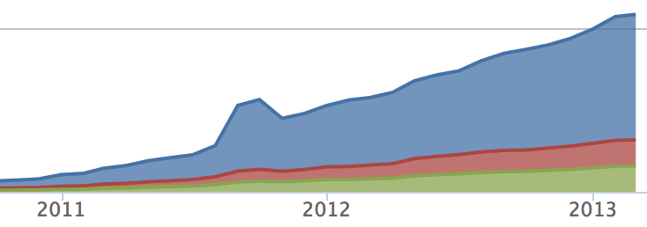
Developer Interest = Rapid Innovation
From 10k lines of code to 800k in less than 3 years

Slide 34
OpenStack Goals
Open platform
Community-driven innovation
Technology accessible in many ways: hourly, appliance, distribution, DIY
Empowered users and developers
Deep engagement from our users and developers
Users have more control of their destiny
Broad, global support from companies
Not driven by a single company; no single source
Aggregate investment is huge
Notes:
‣

Slide 35
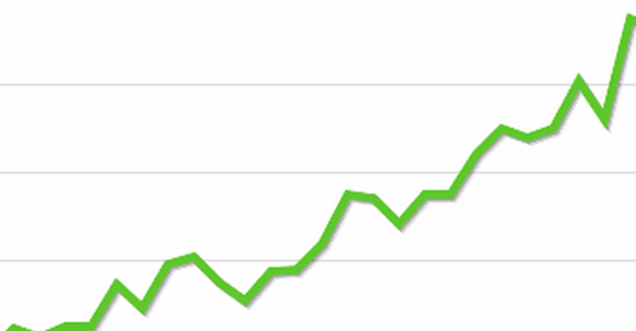
OpenStack.org/Join the revolution

Slide 36
OpenStack
The platform ecosystem for the cloud

