Slide 1

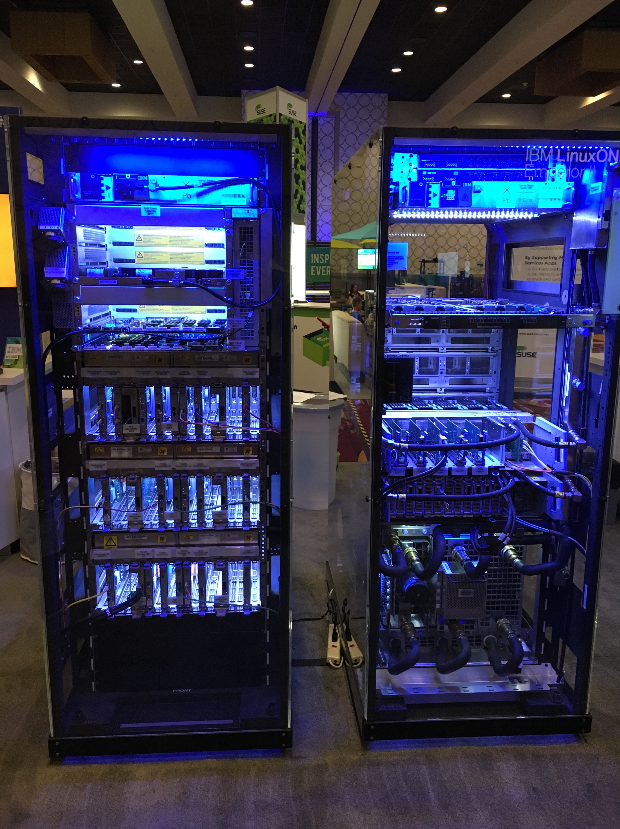
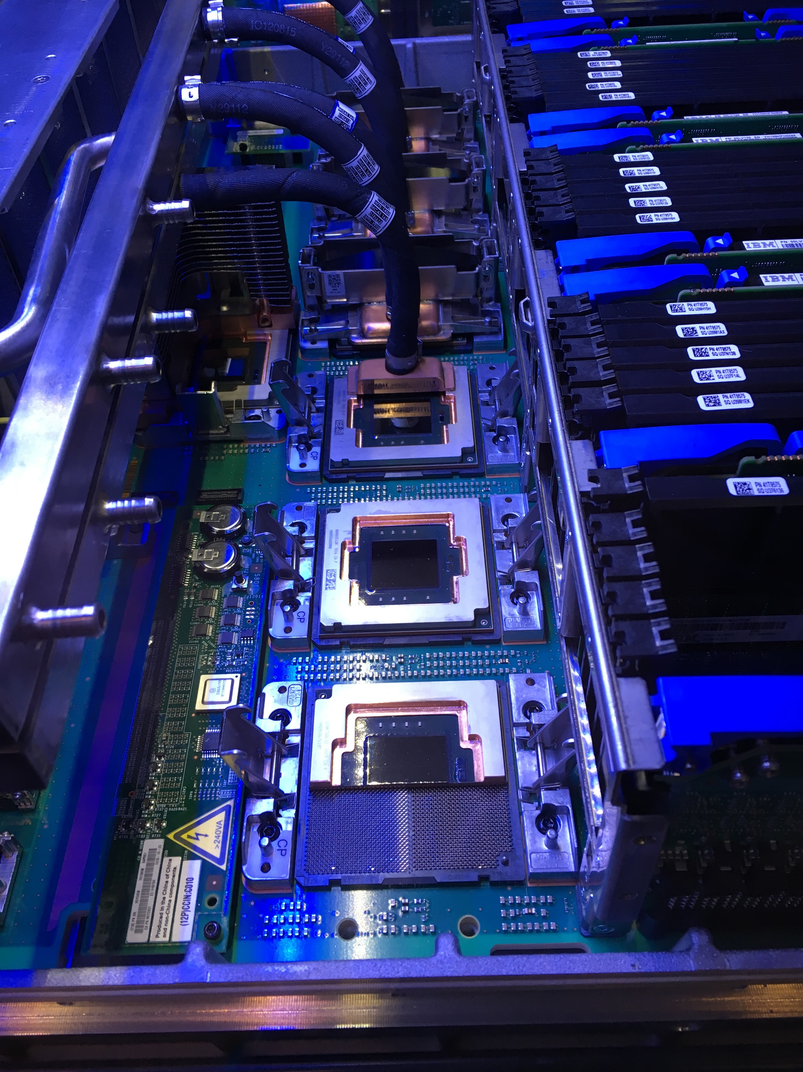
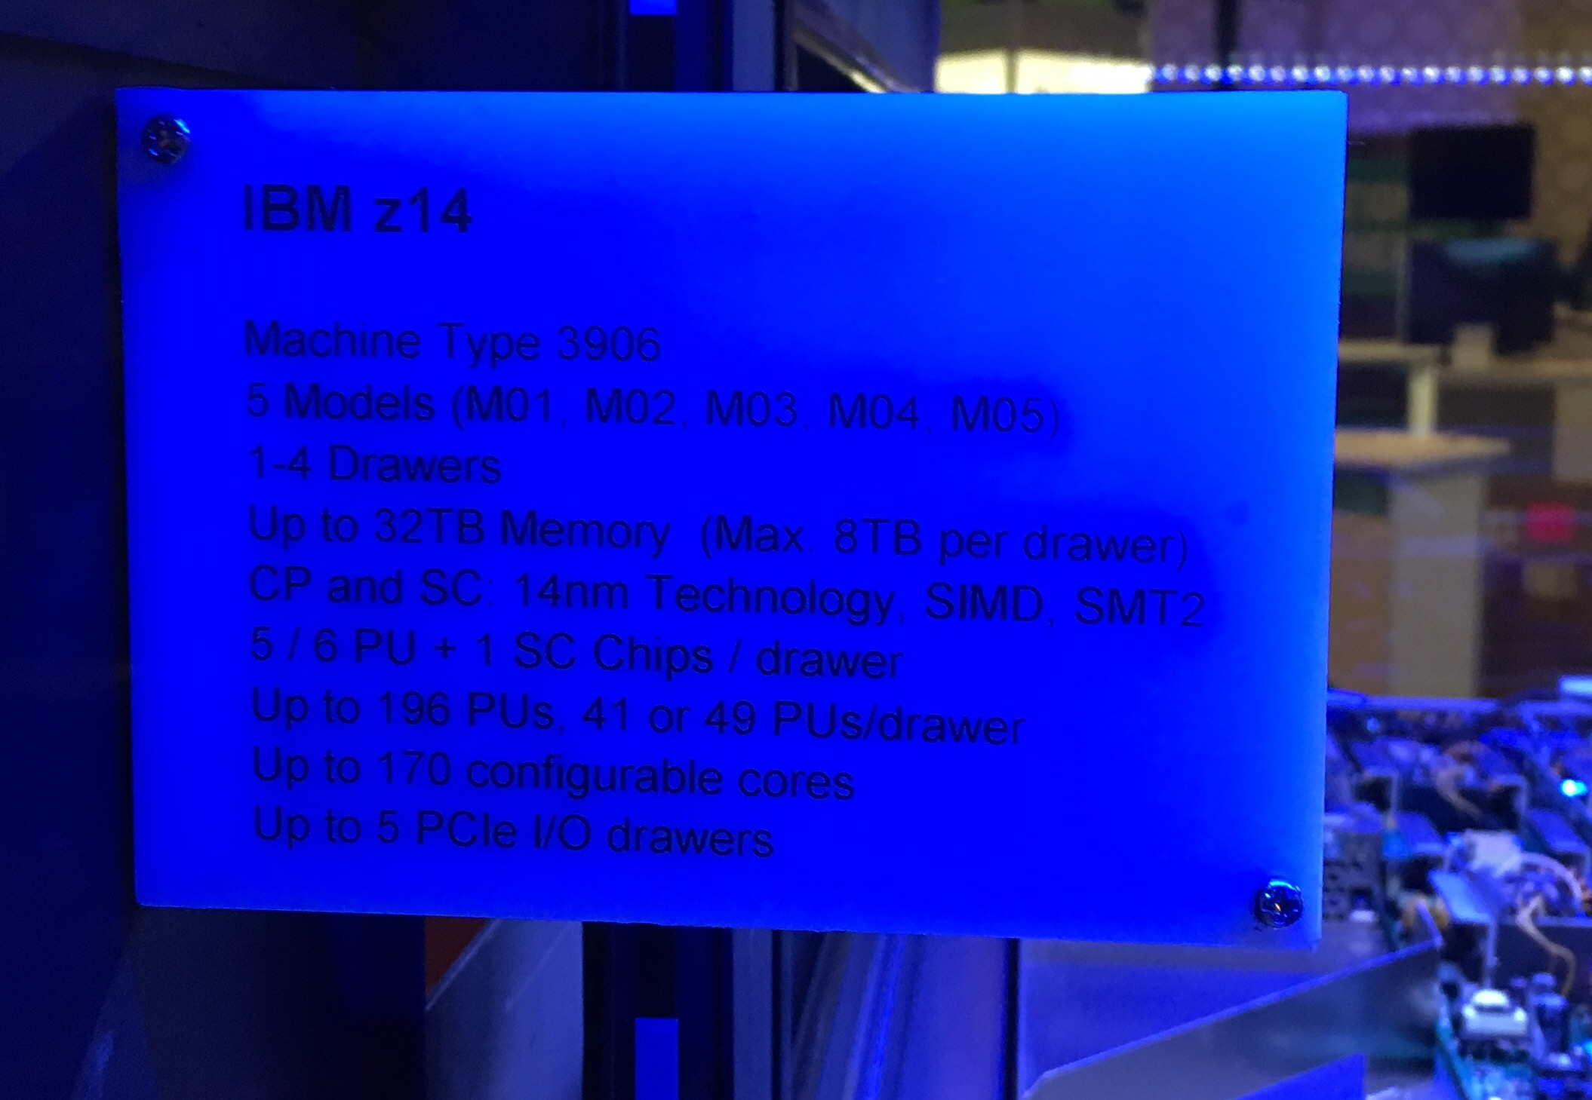

Slide 2


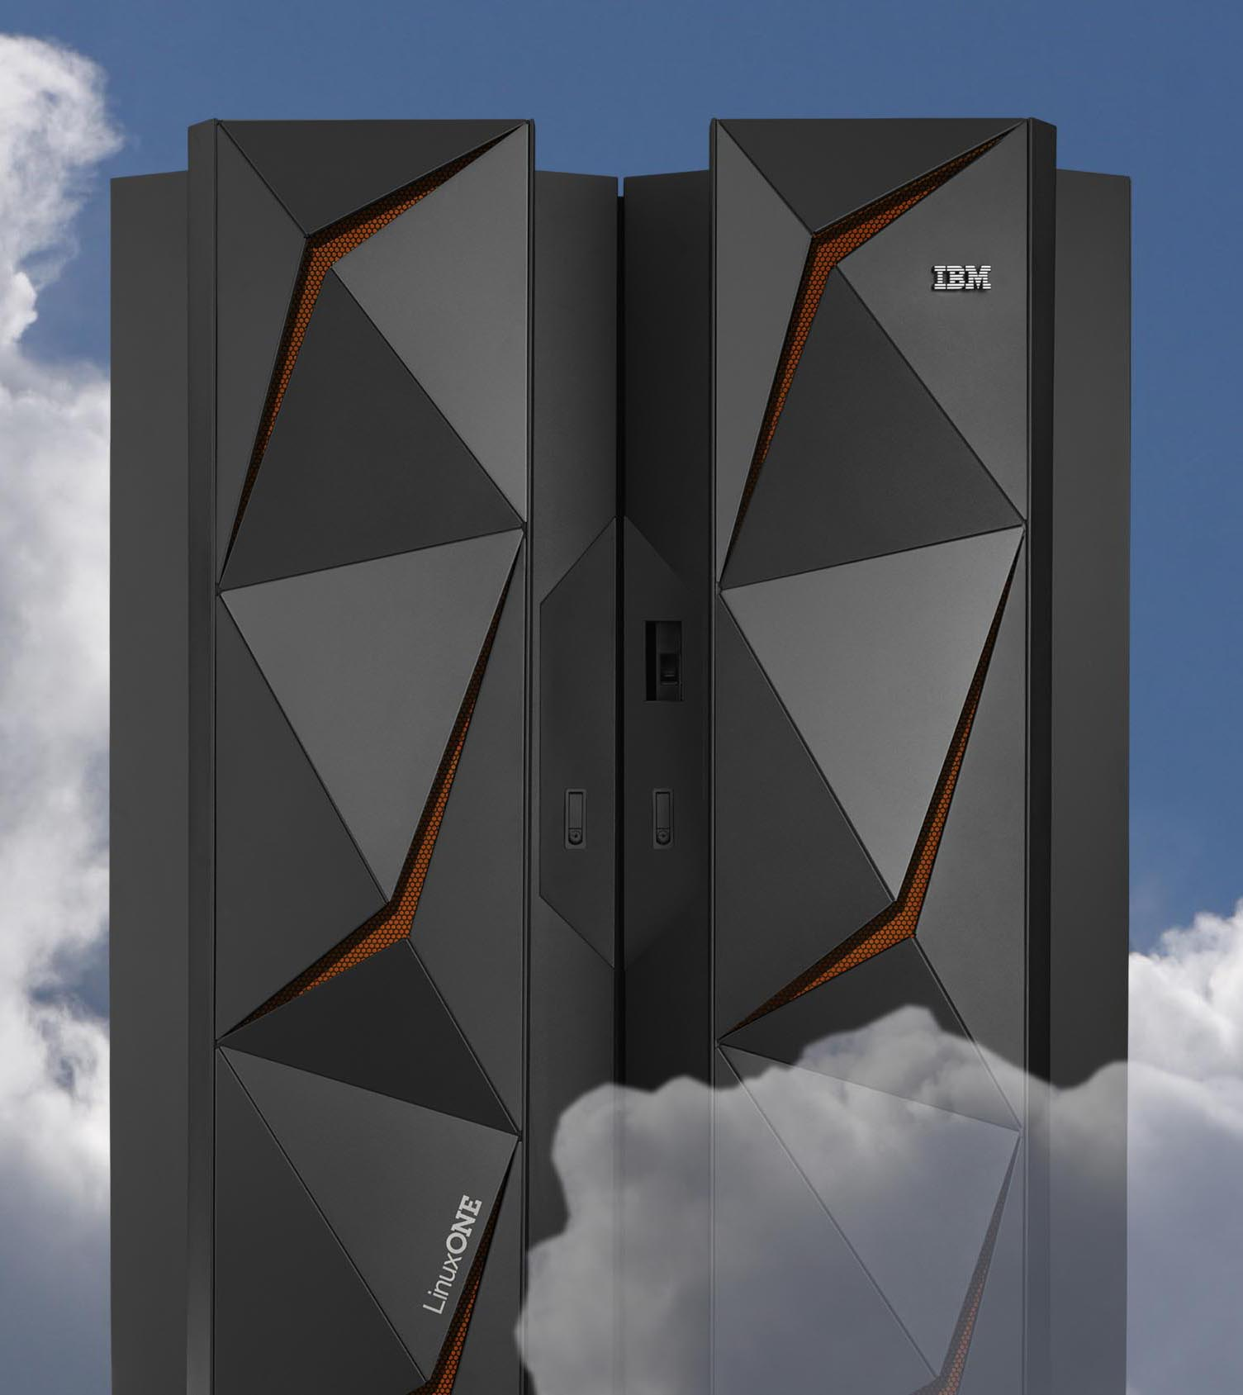


World’s leading businesses run on IBM Z
92 of the top 100 worldwide banks
23 of the top 25 US retailers
10 out of 10 of the world’s largest insurers
23 out of 25 of the world’s largest airlines
processing the world’s transactions & data
80 percent
of the world’s corporate data resides or originates on mainframes
23 billion
ATM transactions per year processed by the mainframe worth more than $1.4 trillion
55 percent
of all enterprise applications need the mainframe to complete transactions
30 billion
business transactions processed on the mainframe per day
$6 trillion
credit and debit card payments processed annually (nearly 100% of all credit card transactions)
3 billion
travelers a year; with 2x that expected by 2030 (mainframes process nearly all air travel reservations)
91 percent
of surveyed CIOs said that new customer-facing applications are accessing the mainframe
Notes:
¹ Based on ‘The Banker’, System z install base and financial records
Based on IBM market development and insights documentation on top 25 ranked by Fortune 500 listing.
Based on IBM market development and insights documentation on top 10 insurance companies, ranked by non-banking assets.

Slide 3
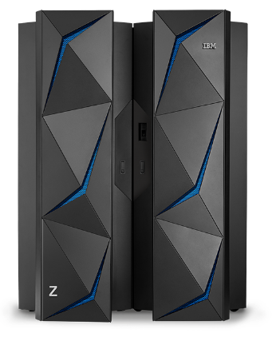
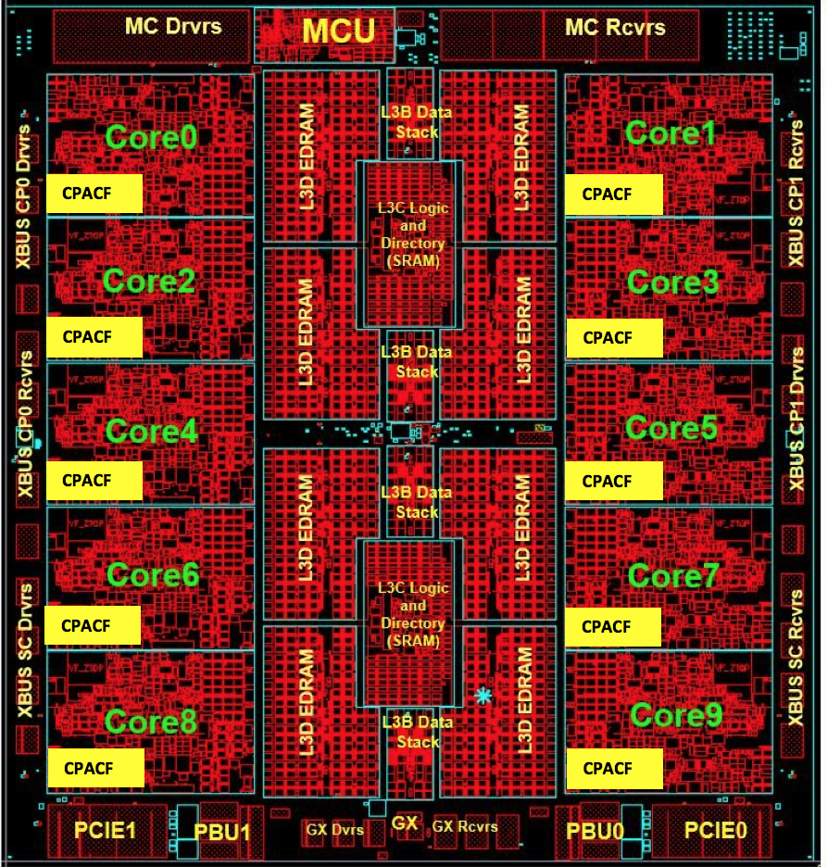
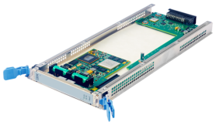
IBM LinuxONE™ Emperor II
Extreme Virtualization and Scale
Hypervisor partitioning built into firmware
    Complete isolation – EAL5+
85 hypervisors– z/VM or KVM
    1k Linux guests/hypervisor
    >2 million docker containers
    Hypervisor communication is via fast, in-memory sockets
      3x less latency than discrete servers
Non-disruptively add/remove Linux resources from Linux guests
Non-disruptively add/remove Linux guests
Built-in error detection and correction for high availability
Security in hardware
Each core has its own cryptographic co-processor
Crypto Express6S PCIe card adds additional crypto capability
  Elliptic Curve, SHA3, Visa FPE, etc.
Meets FIPS 140-2 level 4 , ANSI, PKI, and DK standards
End-to-end pervasive encryption with no performance impact
RAM | Up to 32TB
CPU | Up to 170 cores running at 5.2GHz
Cache | L1/L2 on core L3 on chip 960MB L4 off-chip
I/O | Up to 640 dedicated I/O,RAS and other coprocessors
  14nm SOI Technology
  17 layers of metal
  6.1 Billion transistors
Notes:
IBM LinuxONE first announced August 2015
Single MongoDB node on LinuxONE scales up to 17TBs with sustained throughput and response time <5ms, while supporting +4 Billion documents, 460,000 reads+writes/second, with no sharding required! It is the largest scaled up mongoDB instance ever attempted.
Ran the YCSB benchmark on MongoDB 3.4.1 with up to 2.6x more throughput per core on a LinuxONE Emperor II LPAR versus a compared x86 platform
Run the pgBench benchmark on PostgreSQL 9.6.1 with up to 2x more throughput per core on a LinuxONE Emperor II LPAR versus a compared x86 platform

Slide 4
The promise of open-source data serving on IBM LinuxONE
security
performance
and scalability
availability
minimal
unplanned downtime
Pervasive encryption across the entire system
Protected-keys on LinuxONE provides significantly enhance security over open-key technology, while offering up to 28x better performance over standard
secure-key technology
Isolation on LinuxONE starts at the hardware ...
"What happens in a VM stays
in a VM”
Scale-up a single MongoDB instance to 17 TB on a single system without database sharding
Run the YCSB benchmark on MongoDB with up to 2.6x more throughput per core
Run the pgBench benchmark on PostgreSQL with up to 2x more throughput
Pause-less Garbage Collection. 10X shorter pause-times for Java
IBM LinuxOne
2017 ITIC survey shows
IBM LinuxONE had
no unplanned
system downtime
due to inherent flaws
in hardware
4
Notes:
All tests done on a LinuxONE Emperror II system
MongoDB 3.4.1 and PostgreSQL 9.6.1 used in the test

Slide 5
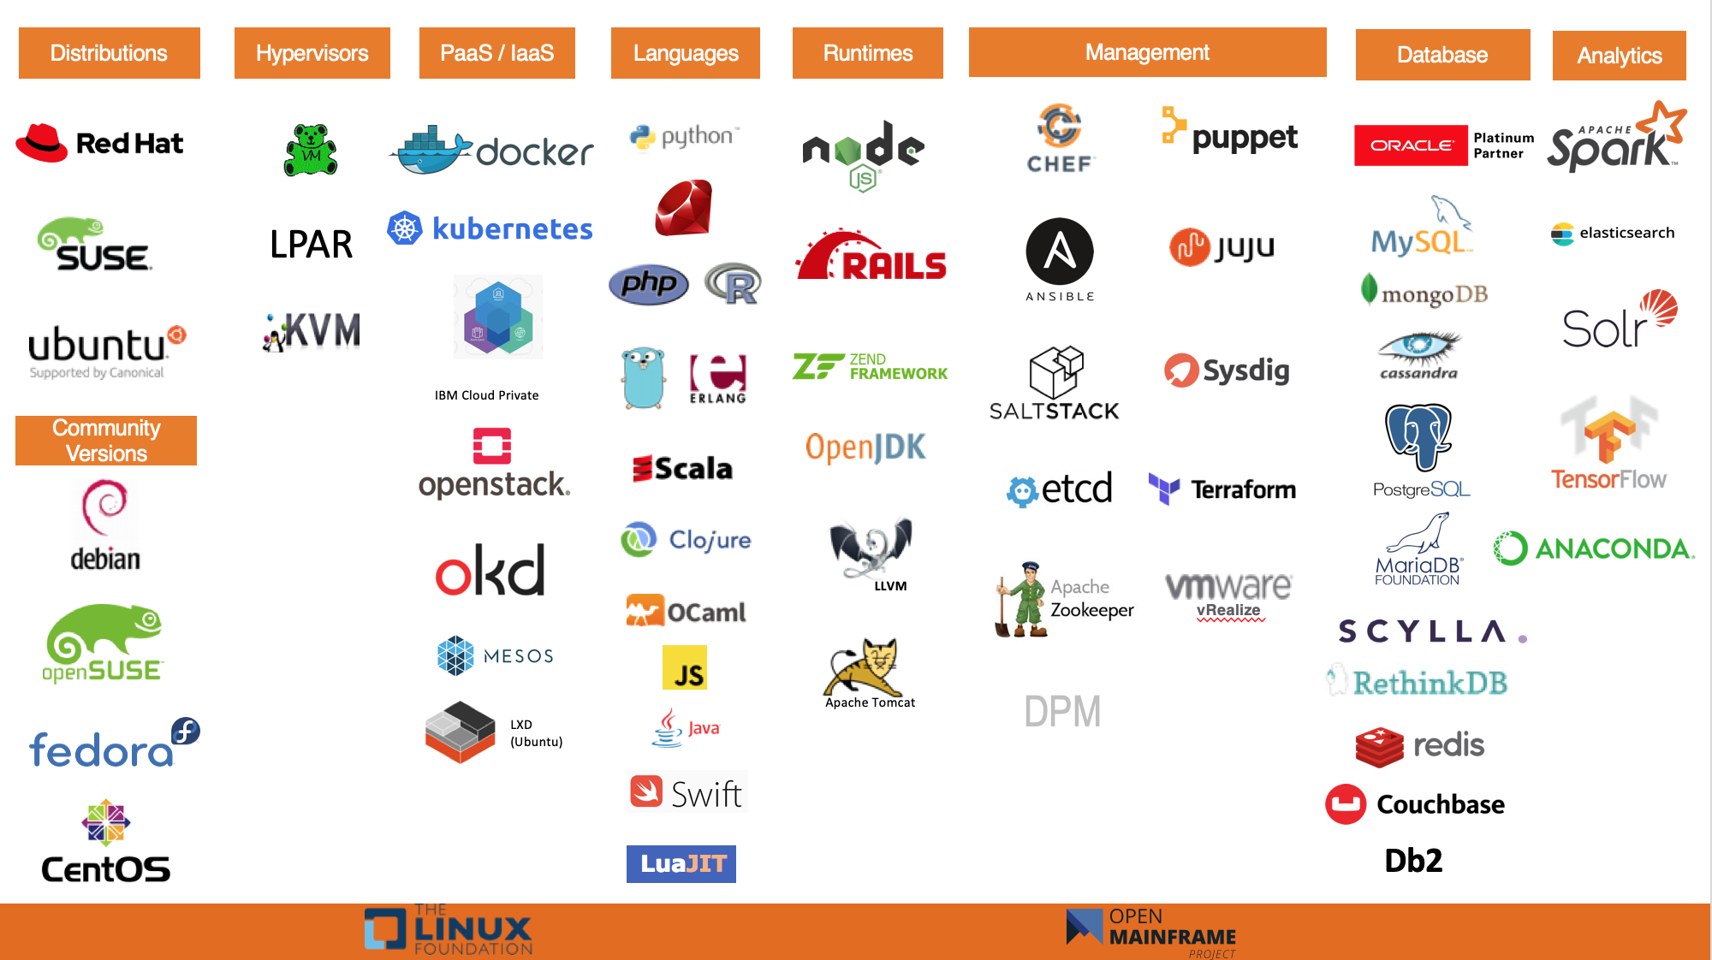
A rich ecosystem already runs on LinuxONE and IBM Z

Slide 6

IBM LinuxONE™ Community Cloud
Wondering how your code will run on LinuxONE?
The IBM LinuxONE Community Cloud provides a no charge, self-provisioned SUSE or Red Hat virtual machine on an IBM LinuxONE Enterprise Server (s390x architecture) to develop, test, and run your apps.
https://developer.ibm.com/linuxone

